Slide 1
Drone Control Status Update
Adin Sacho-Tanzer and Gabriel Kret

Slide 2
Introduction
Aircraft dynamics simulators are helpful to test controllers without needing to run an expensive real world test
Implementation:
Use RK4 integrator
Use quaternions for equations of motion
Apply linear aerodynamic model over the Rigid Body -Updated
Calculated trim conditions
Implemented PID Controller in Autopilot Class
Tuned PID control to achieve satisfactory and stable flight conditions

Slide 3
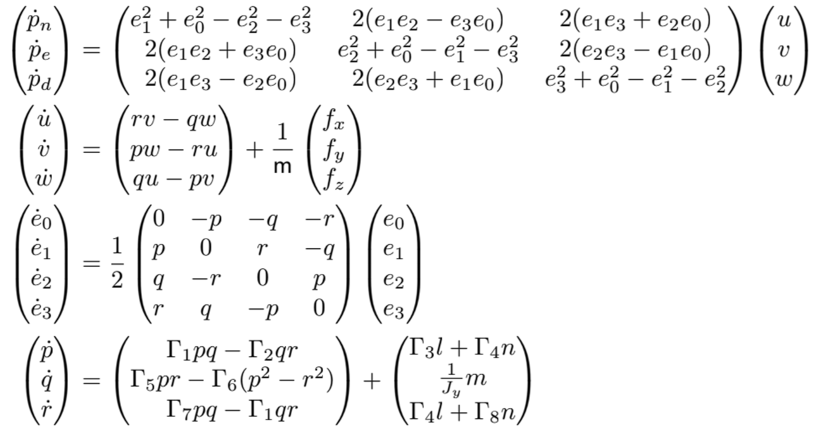
EOMs

Slide 4
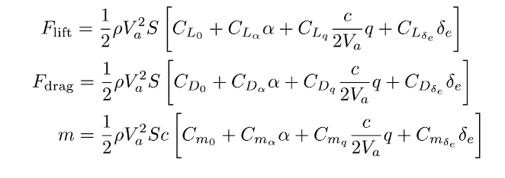
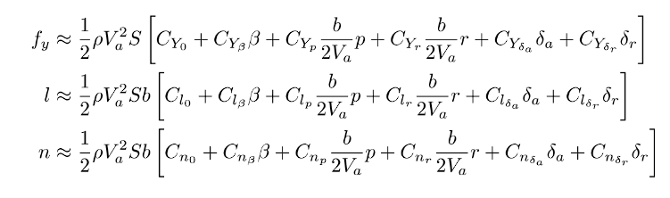
Linear Aerodynamic Model

Slide 5
Implementation
Used code structure from Beard
Rigid body class implements rigid body EOMs.
Aircraft class implements aerodynamics, thrust, gravity, and wind.
Trim conditions computed using Jacobians and minimize function.
Added PID control
Tunned PID using methods to be discussed
Testing:
For aerodynamics, used Beard’s chapter 4 test cases (this latest update validated our wind functions)
Verified with another group that they got the same trim conditions.
PID control validates itself by showing well-controlled flight dynamics.

Slide 6
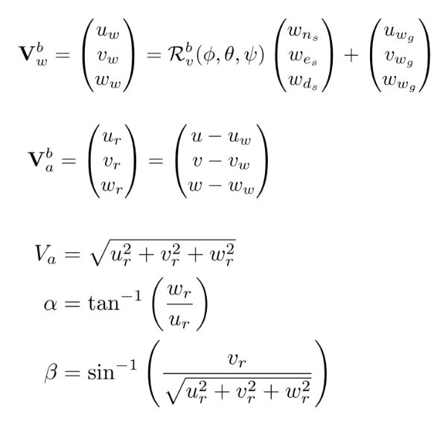
Wind

Slide 7
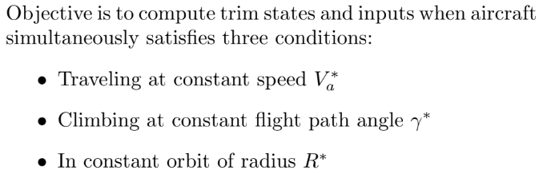
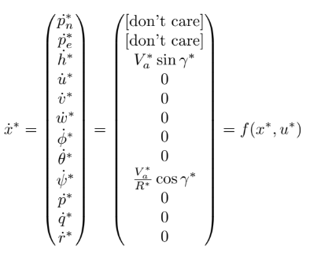


Trim Conditions
Goal: Converge to the trim objective function via minimization and enforcement of the trim constraints.
NOTE: when evaluating our state derivatives at trim conditions we expect all relevant results to be zero (see next slide). Our implementation achieved this except for q_dot which was non-zero.

Slide 8
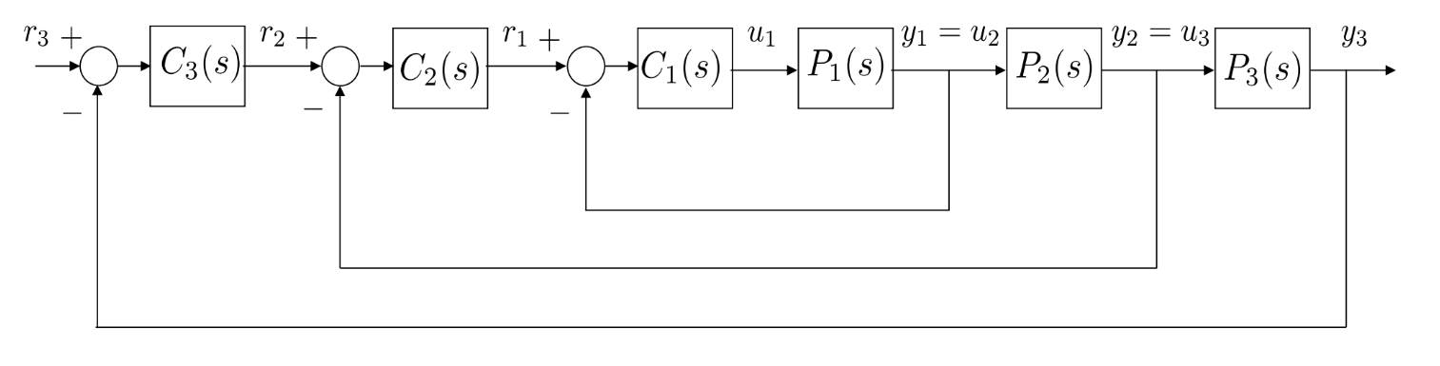
Implementing PID w/ Successive Loop Closure
SLC is a step-by-step method where you tune and close one control loop at a time, starting from the innermost loop, then moving outward, to keep the system stable and easier to control.
The inner loops then act as a DC gain on the outer loops.
The above loop is generic. We implement the above controller in the Autopilot class for both lateral and longitudinal control.
We can then tune the gains appropriately to achieve satisfactory flight dynamics.

Slide 9
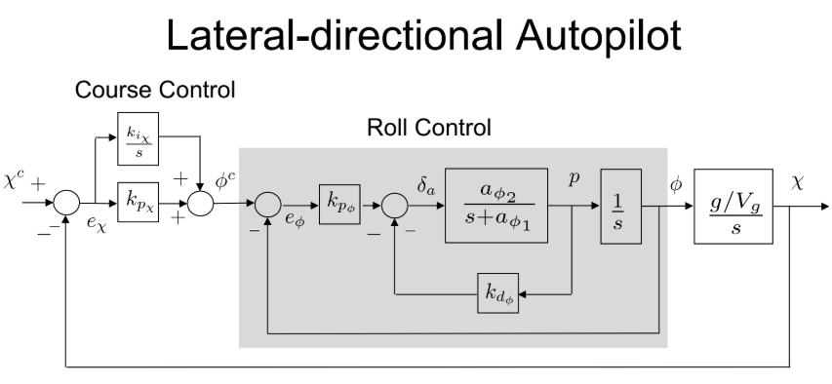
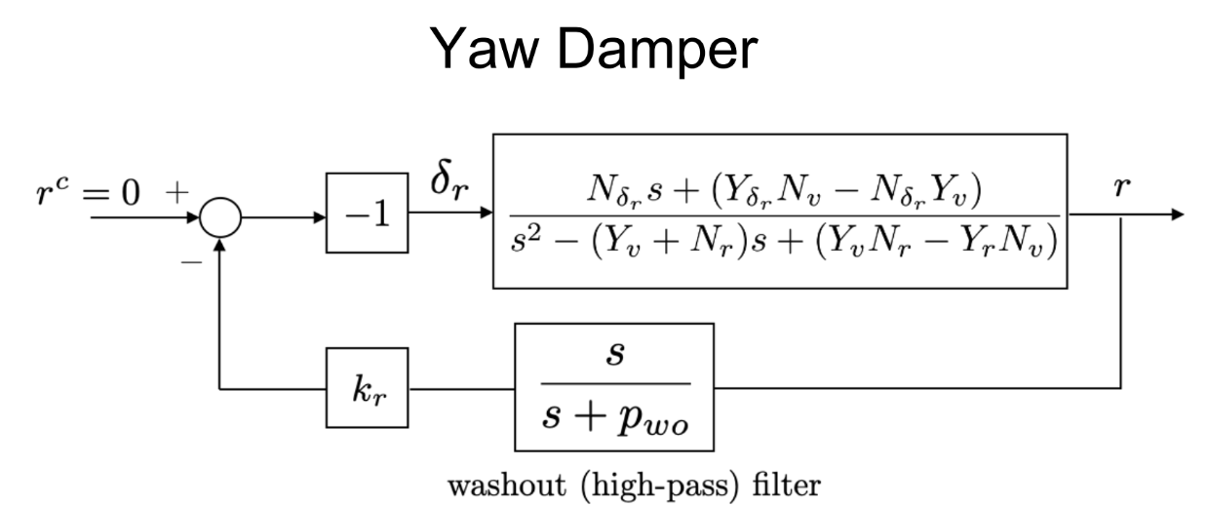
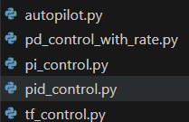
Implementing PID
Implemented the autopilot class which holds the “components” capable of control (Aileron, Yaw Damper, Throttle, etc.)
The autopilot class applies the appropriate controller to the component.
For instance, Throttle is controlled with PI while Roll is controlled with PD (+rate control).
Each of the controllers (PD, PI, PID, TF) is implemented with their unique control law called to each parameter in the Autopilot class.

Slide 10
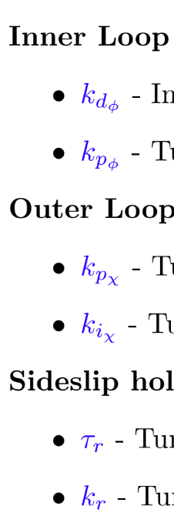
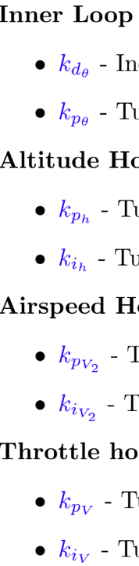
First try: PID Tuning
Longitudinal
Control
Lateral Control
Beard provides not so specific direction on how to properly tune the PID controller gains manually.
Tried and achieved little success with Ziegler-Nichols (ZN).
We ended up using a mix-and-match technique between Beard’s method, ZN, and a guess-and-check.

Slide 11
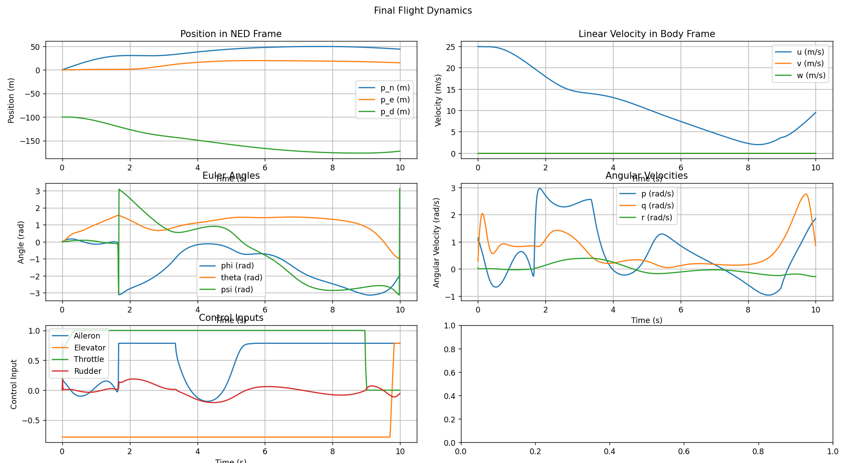
Results 1

Slide 12
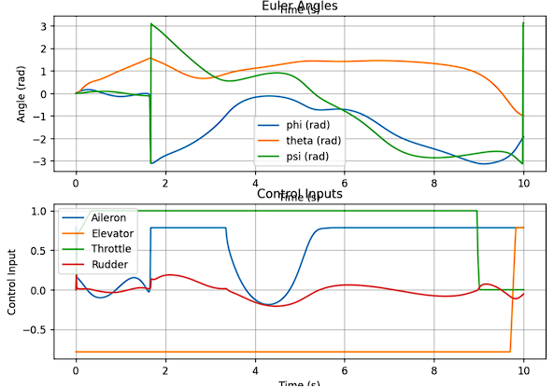
Results 1: Issues
Commanded airspeed = 25 m/s, no commanded climb
Flat spin (yaw instability)
Elevator and Throttle saturation

Slide 13
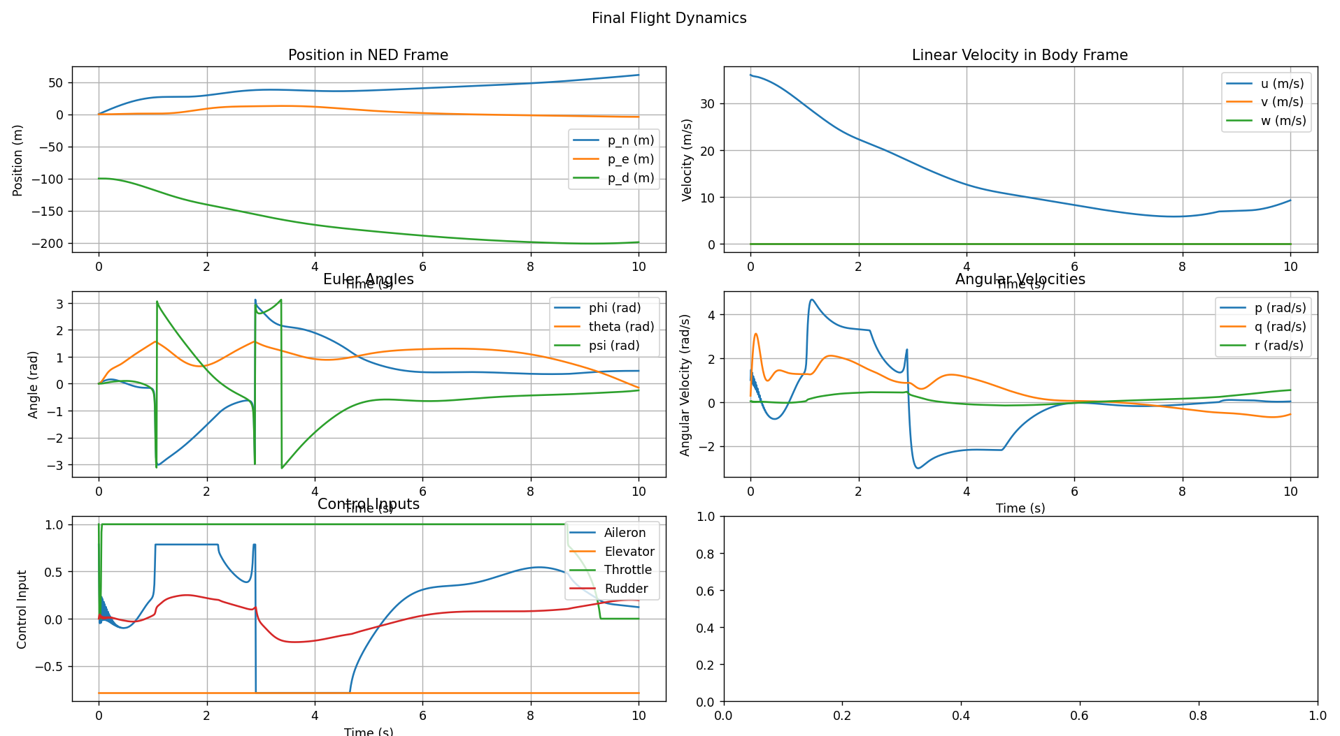
Results 2

Slide 14
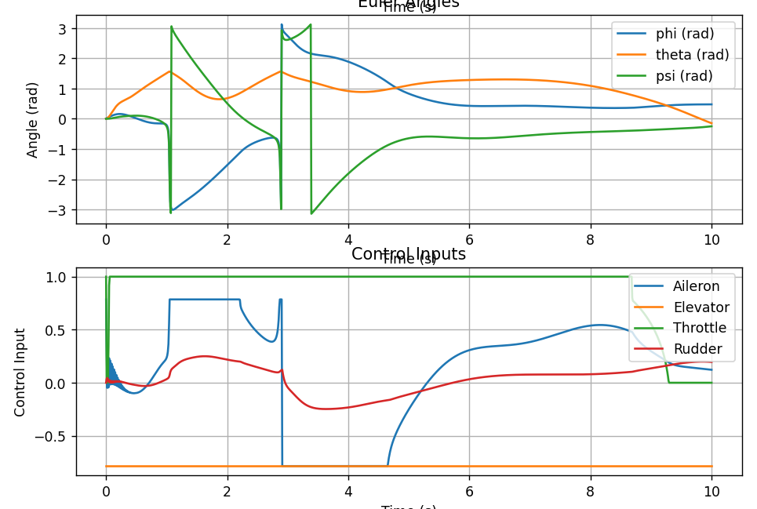
Results 2: Issues
Commanded: airspeed = 36m/s, no climb
Found to be trim condition
Same issues as before:
Throttle saturation
Elevator saturation
Flat spin

Slide 15
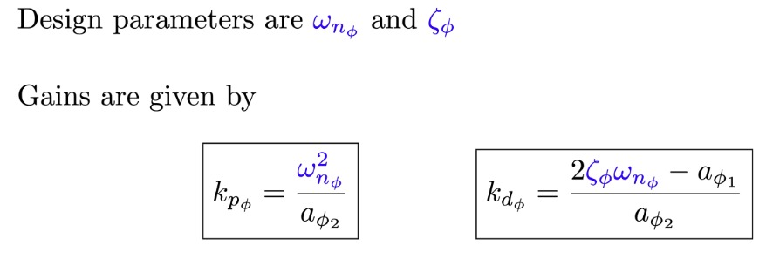
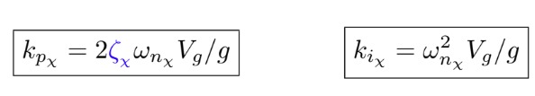
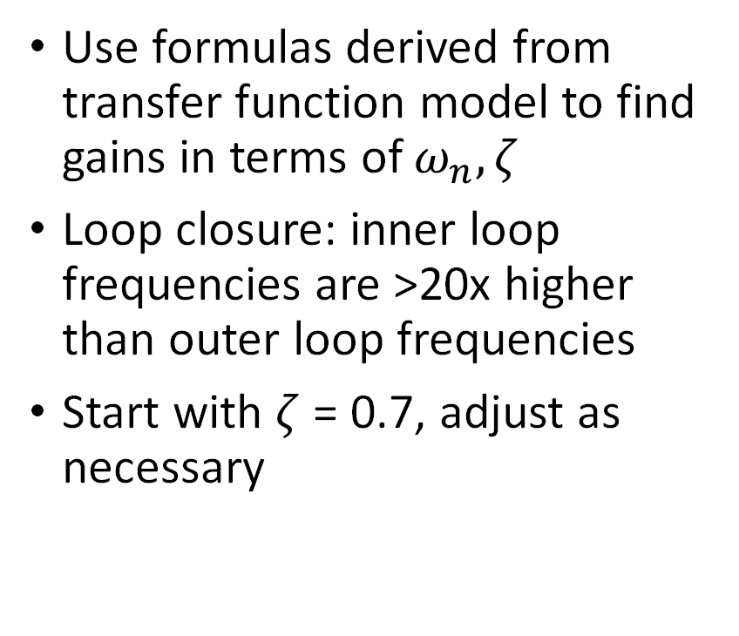
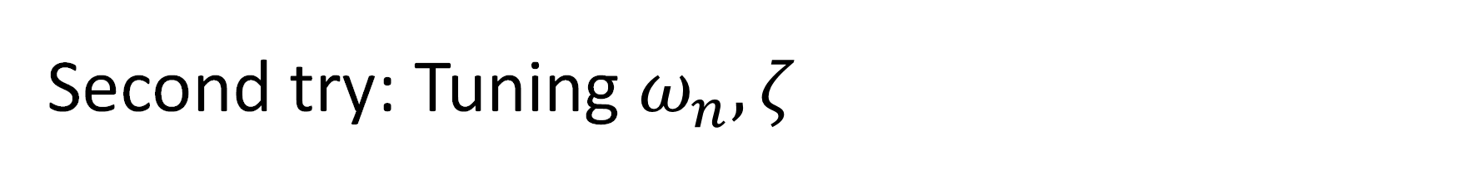
Second try: Tuning $ω_{n}, ζ$
Use formulas derived from transfer function model to find gains in terms of $ω_{n}, ζ$
Loop closure: inner loop frequencies are >20x higher than outer loop frequencies
Start with $ζ$ = 0.7, adjust as necessary

Slide 16
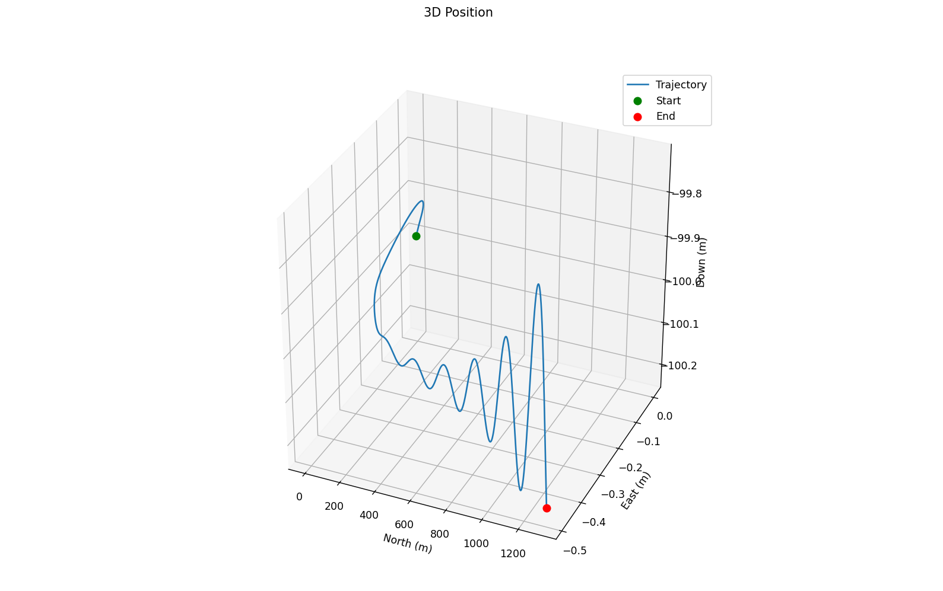
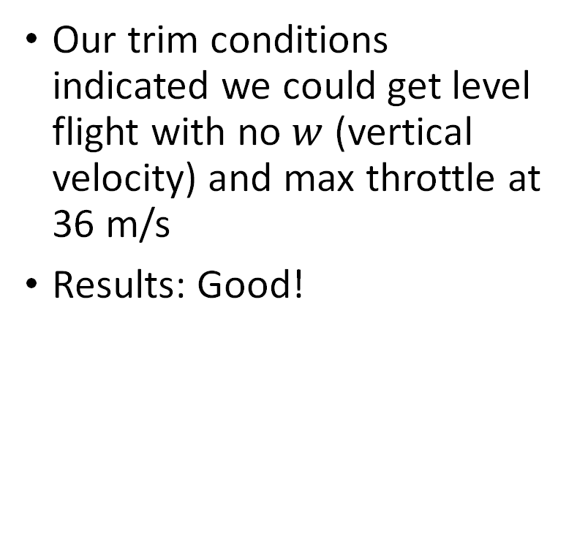
Successful Test:
Our trim conditions indicated we could get level flight with no $w$ (vertical velocity) and max throttle at 36 m/s
Results: Good!

Slide 17
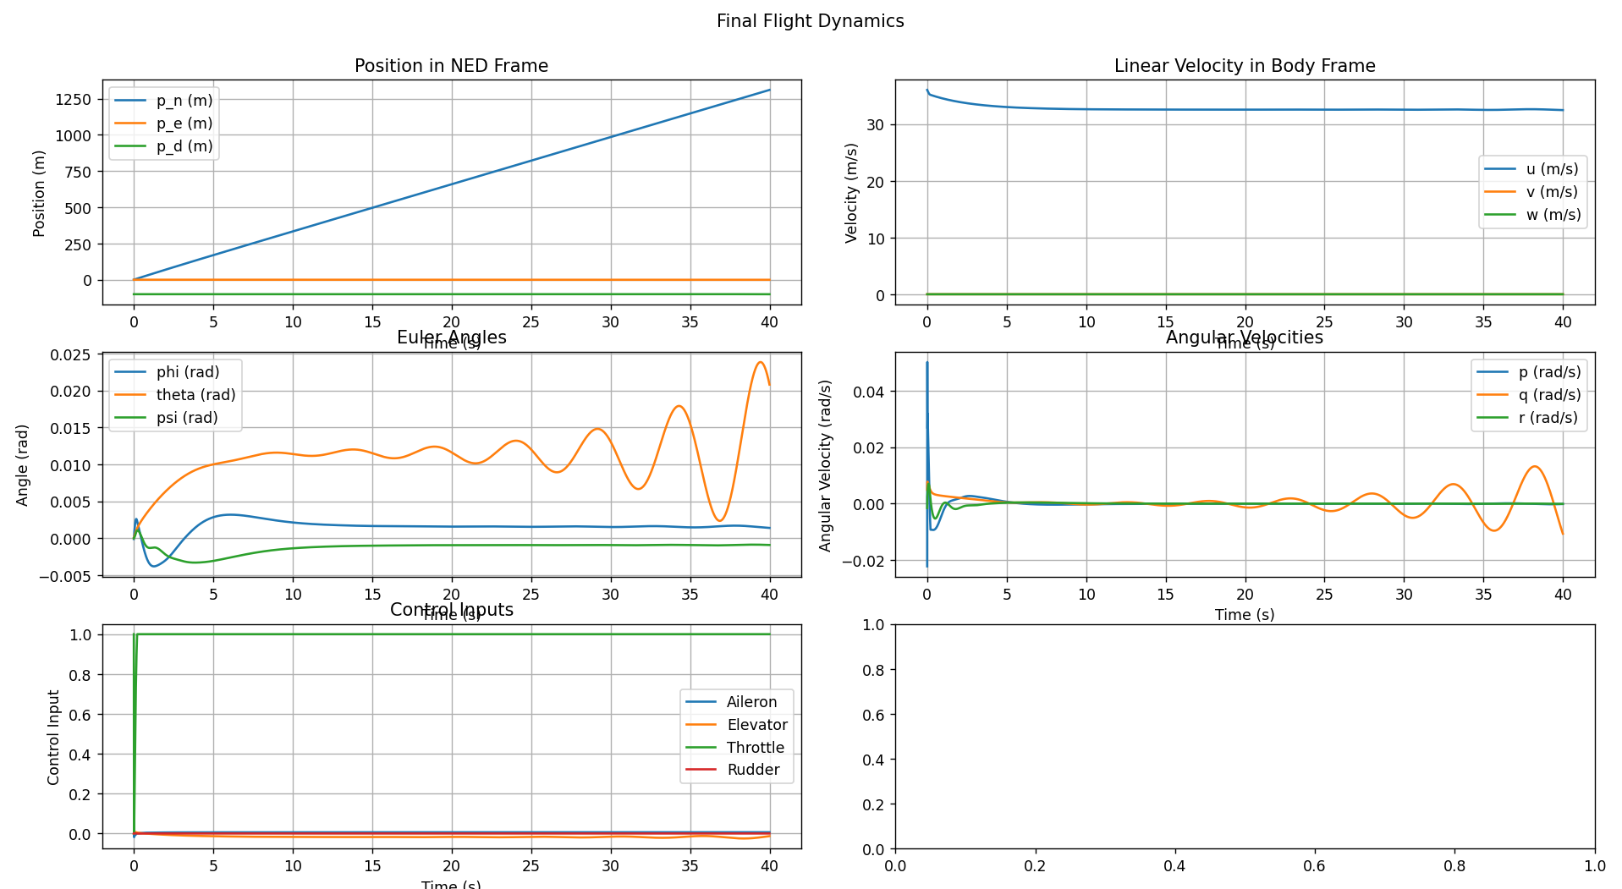
Successful Test:

Slide 18
Results
Beard Chapter 4 & 5 test cases:
Matched test cases appropriately for forces and moments, and wind.
Properly calculated trim conditions
Beard Chapter 6 :
Implemented PID
Tuned PID to optimize flight conditions

Slide 19
Challenges
Had to restart code using Beard’s structure
Originally implemented our own structure using Euler angles
Ran into persistent errors, couldn’t figure out why
General challenge- testing and debugging is hard
Can really only test using Beard’s cases
When a test fails, it’s extremely hard to figure out where the problem is
Tuning PID is even harder
There are many parameters to tune and no straightforward method to go through to tune appropriately.

Slide 20
Conclusion
There’s more work to be done.
Learn more about how to better tune the controller.
Continue progress with Sensors (Ch 7) and State Estimation (Ch 8)

